Slide 1
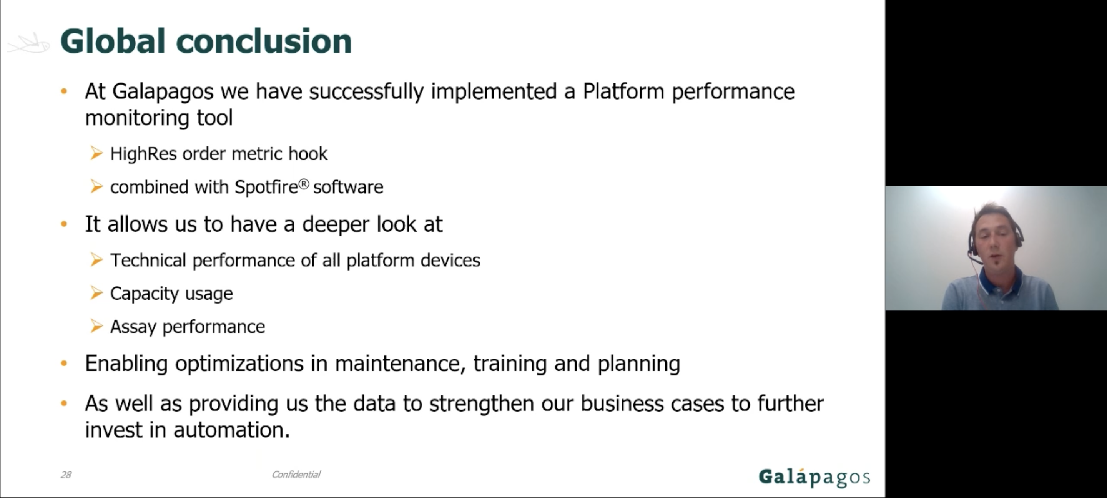
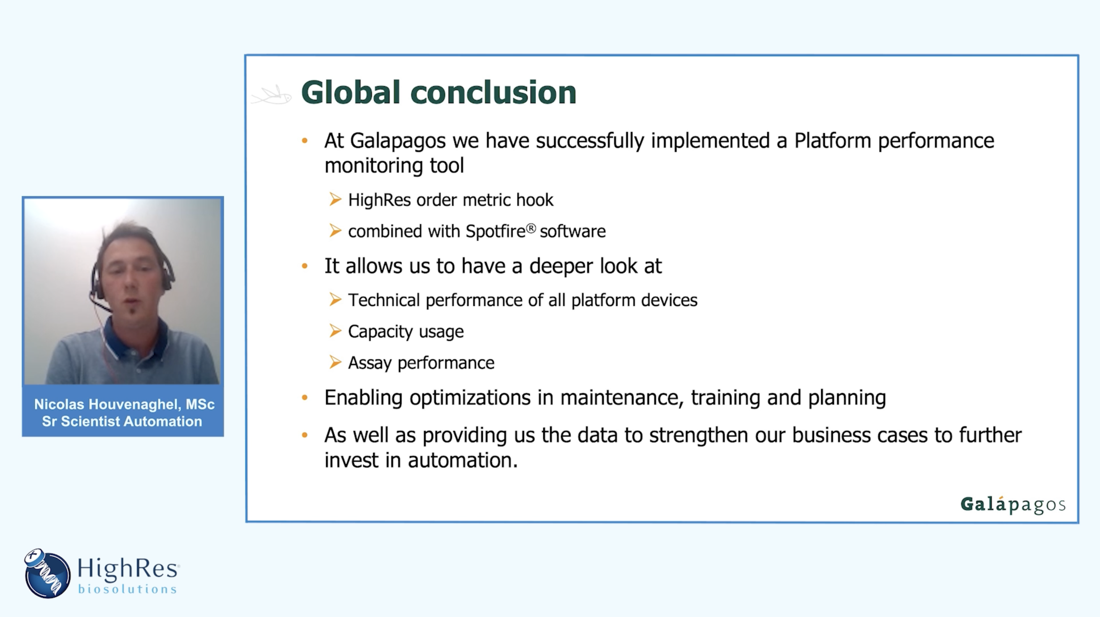

Webinar Re-Purposing
Before
HighRes® Biosolutions, a leading global laboratory automation company, was seeking to repurpose a webinar presentation recorded in partnership with another biotechnology company. They were looking to create social posts designed for publication on their website. Our team edited together social-ready highlights of the presentation and enhanced the original recording’s audio and graphics for online publication.
Our Work
Re-oriented speaker and deck slide video frames
Color-corrected original speaker footage
Added brand-aligned background and logo assets
Added stakeholder-approved intro and outro graphics
Added transition effects to deck slides
Enhanced audio quality across all final video assets
Generated closed-captioning across all final video assets
After
The Result
Delivery of CC’d and non-CC’d versions of the enhanced original webinar along with 4 social-ready repurposed video clips:
  LinkedIn Social Post
  Final assets
Social Post

